Slide 1
Deep Sky Modeling for Single Image Outdoor Lighting Estimation
Poster #147
Yannick Hold-Geoffroy, Akshaya Athawale, Jean-François Lalonde
Adobe Research
Indian Institute of Tech. Dhanbad
Université Laval

Slide 2
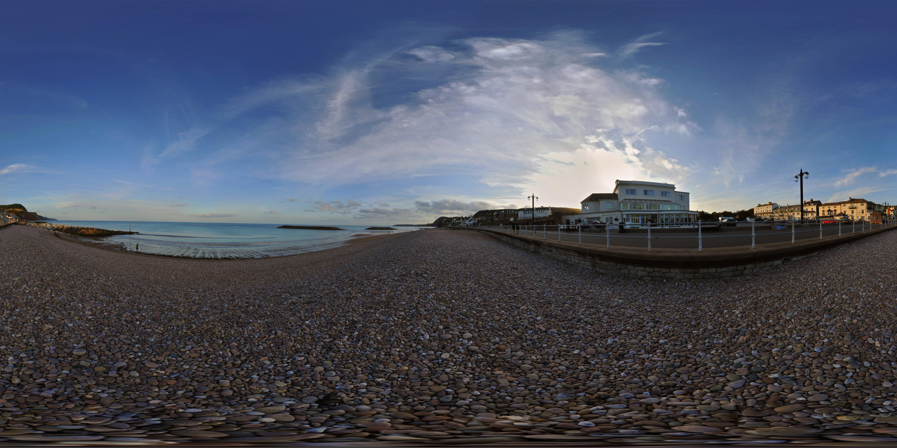
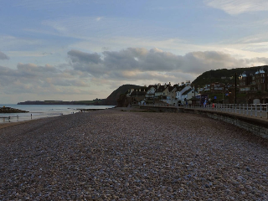
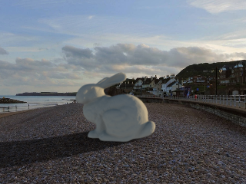
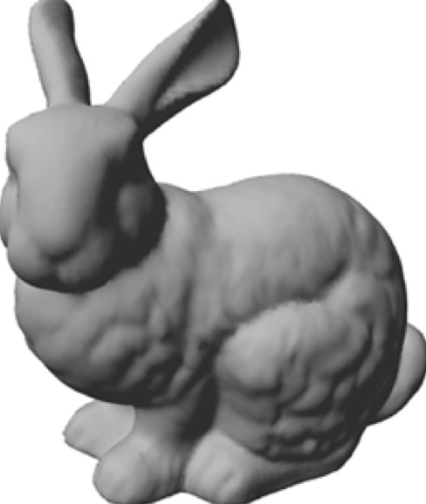
The importance and difficulty of lighting estimation
Notes:
Let’s suppose I have this background photo, and I want to insert this virtual bunny in this photo, and obtain a result such as this one. To do so and obtain a realistic result, I need to light the bunny with the same lighting than the background image. However, lighting is not bound by the camera frame, the scene lighting comes from all around the image.

Slide 3
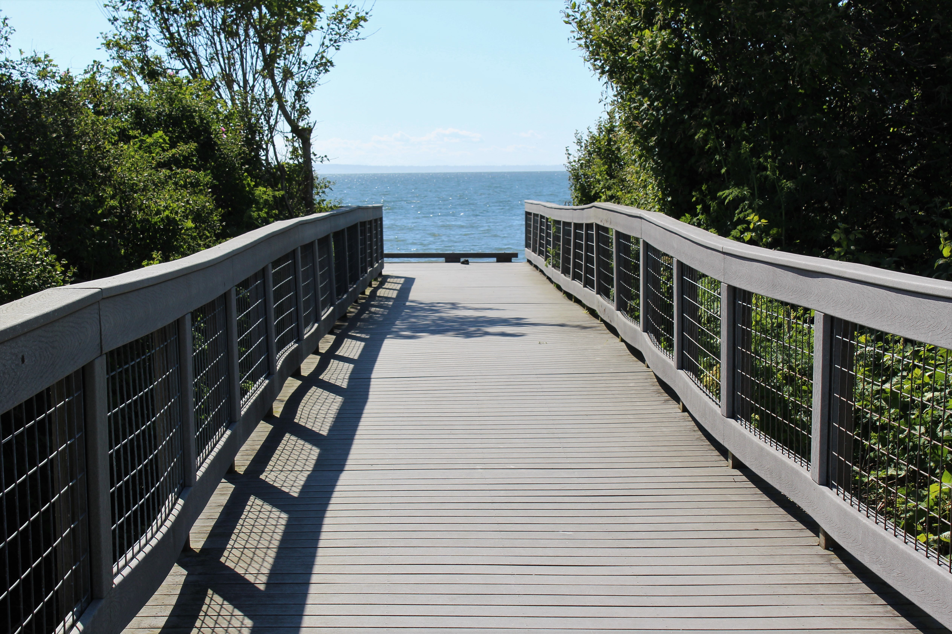
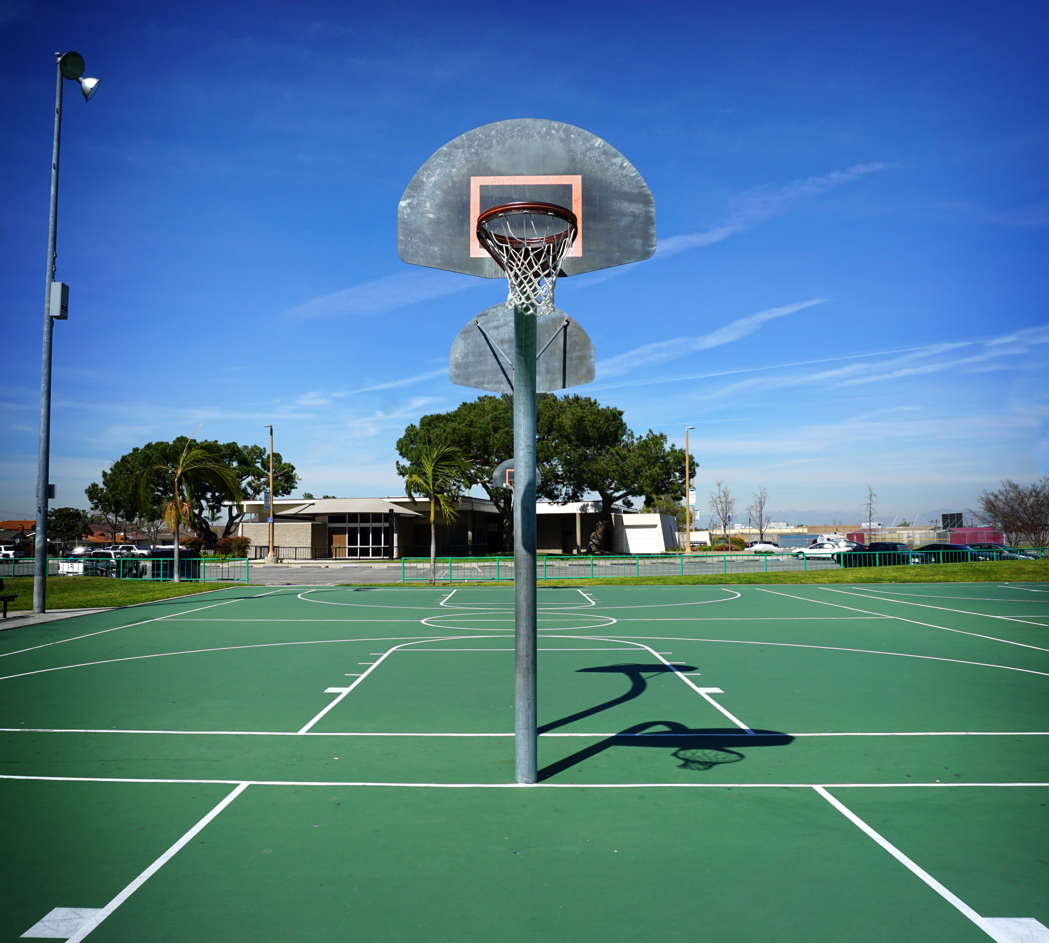
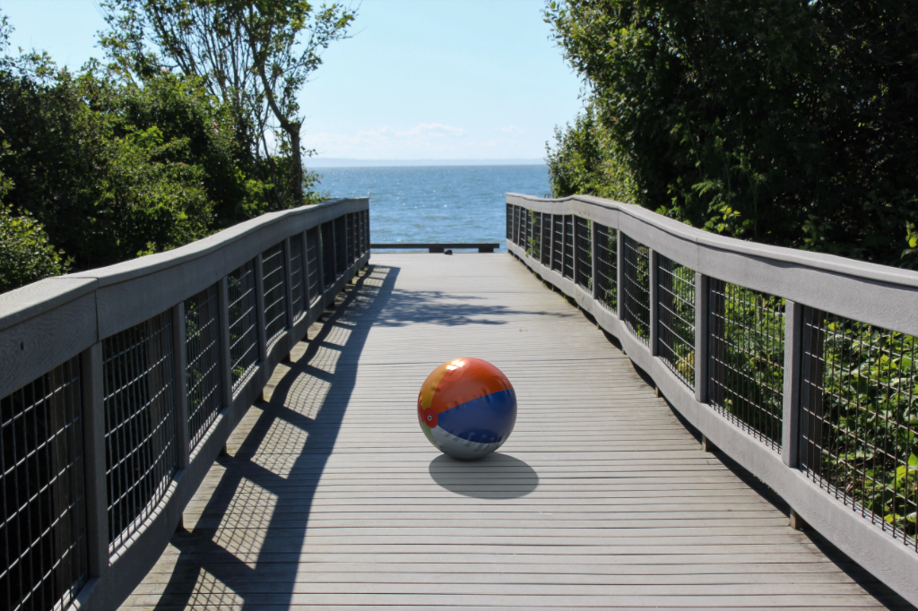
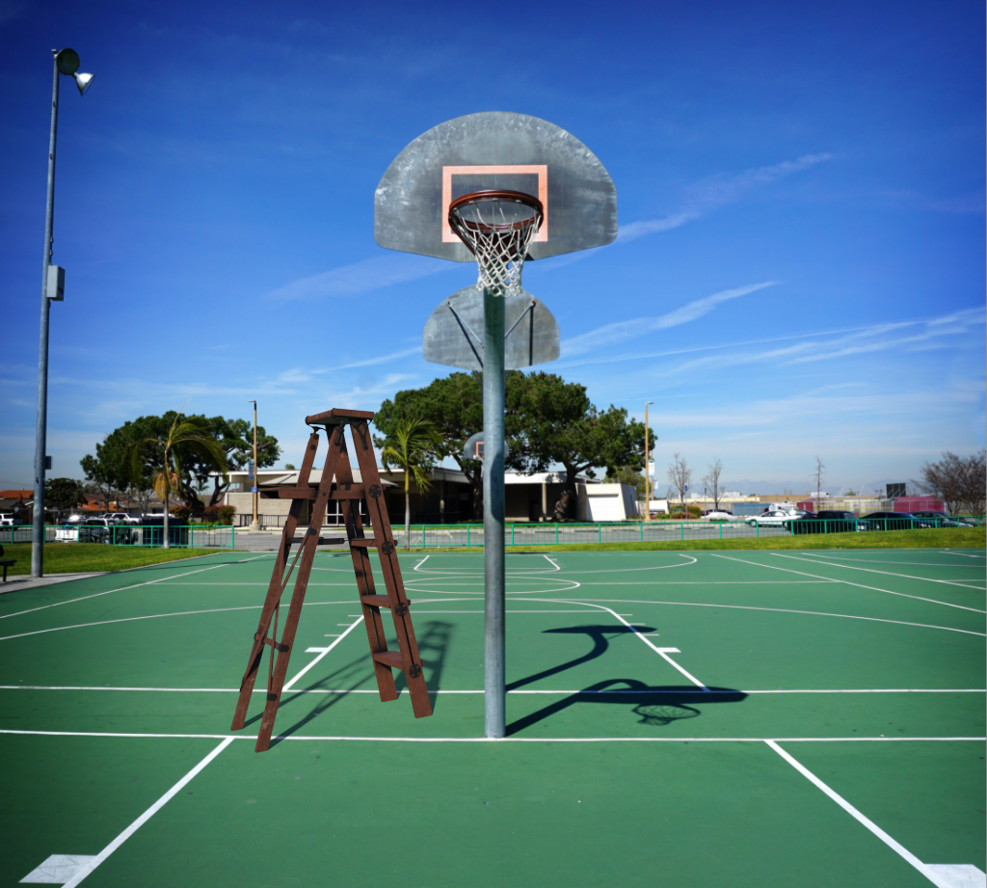
Results obtained with the current state-of-the-art
Notes:
Using this technique, we can take this image and obtain automatically the lighting for a beach ball, for example. Here is another example of a basketball court. I will bring your attention to the shadow direction, which closely matches existing elements in the scene.

Slide 4
Troubles in the sky
Ground truth
Estimation (Hošek-Wilkie)
Notes:
However, the sky lighting model employed in this work I just shown, which is called Hosek-Wilkie (HW), is pretty optimistic. The vast majority of predicted days are sunny and cast strong shadows, even though the sky was overcast that day. So this parametric sky model does not model all possible skies.

Slide 5
State-of-the-art lighting estimation (Hold-Geoffroy et al. ’17)
Illumination
Parametric sky model
(sun position & sky turbidity)
Deep Neural Network
Image
non-linear fit
Panorama
Notes:
The main insight of the current state-of-the-art is to start from panoramas. Getting lighting parameters such as sun position and sky turbidity is easier to get from a non-linear fit on the panoramas than from images. Similarly, we can crop the panorama to obtain an image. Using these pairs of images and their illumination properties, it is possible to train a model to regress the sky model parameters.

Slide 6
Illumination capture and estimation
Learned sky model
Works only on sunny days
Parametric sky model
[Hold-Geoffroy et al ’17]
Learned sky model (ours)
[Hold-Geoffroy et al ’19]
Notes:
The current state-of-the-art for lighting estimation uses a parametric sky model to represent outdoor illumination. In contrast, to represent more variety of weather conditions than mostly sunny, our key insight is to learn a sky model from the data and use it to predict lighting from a single image. In this work, we use captured skies directly to build our sky model in a data-driven manner.

Slide 7
Diversity of sky model
Hošek-Wilkie Sky Model
Real Life
Notes:
However, the state-of-the-art uses a parametric sky model that was designed for sunny skies. If we compare some of its outputs to the richness of real skies, we see that the parametric sky model does not accurately captures the diversity present in nature.

Slide 8
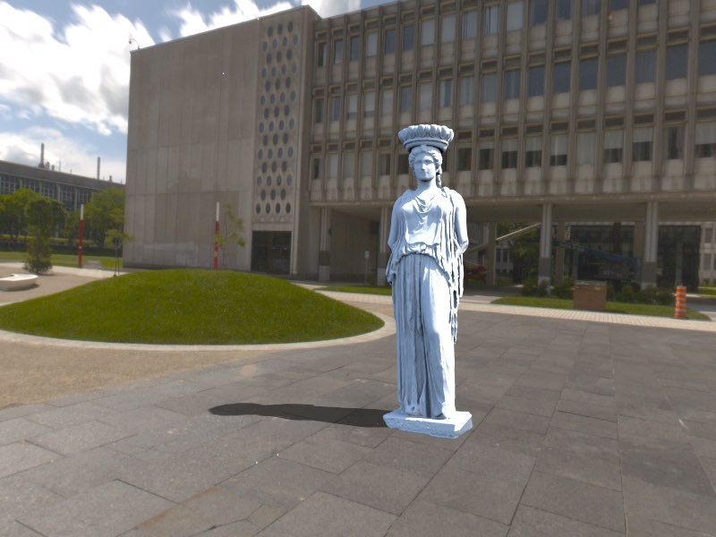
Expressiveness of sky model (Hold-Geoffroy et al. ’17)
Sunny
Cloudy
Image taken from: All-Weather Deep Outdoor Lighting Estimation, J. Zhang, K. Sunkavalli, Y. Hold-Geoffroy,
S. Hadap, J. Eisenman, and J.-F. Lalonde, CVPR’19
Notes:
Using this sky model, and the background as input, we can insert the virtual statue plausibly, with a nice shadow. When the background Is cloudy though, we obtain a strong shadow with doesn’t match the background lighting condition.

Slide 9
Training a data-driven sky model
Hošek-Wilkie Sky Model
Learn from Real Life
Notes:
Our insight is to leverage this richness of the real world.
In this work, we learn a data-driven sky model, trained directly on sky captures.
And since we’re training our deep neural network on skies, we call our method SkyNet.
Now the question is…

Slide 10
Encoder
Latent Vector
Image
Illumination
(environment map)
Decoder
Encoder
Panorama
Notes:
A typical way to do that is to directly regress some lighting parameters from the image using a deep neural network. The parameters can be estimated from a panorama, from which we take a crop.

Slide 11
How do we train
SkyNet*?
*and keep it under control

Slide 12
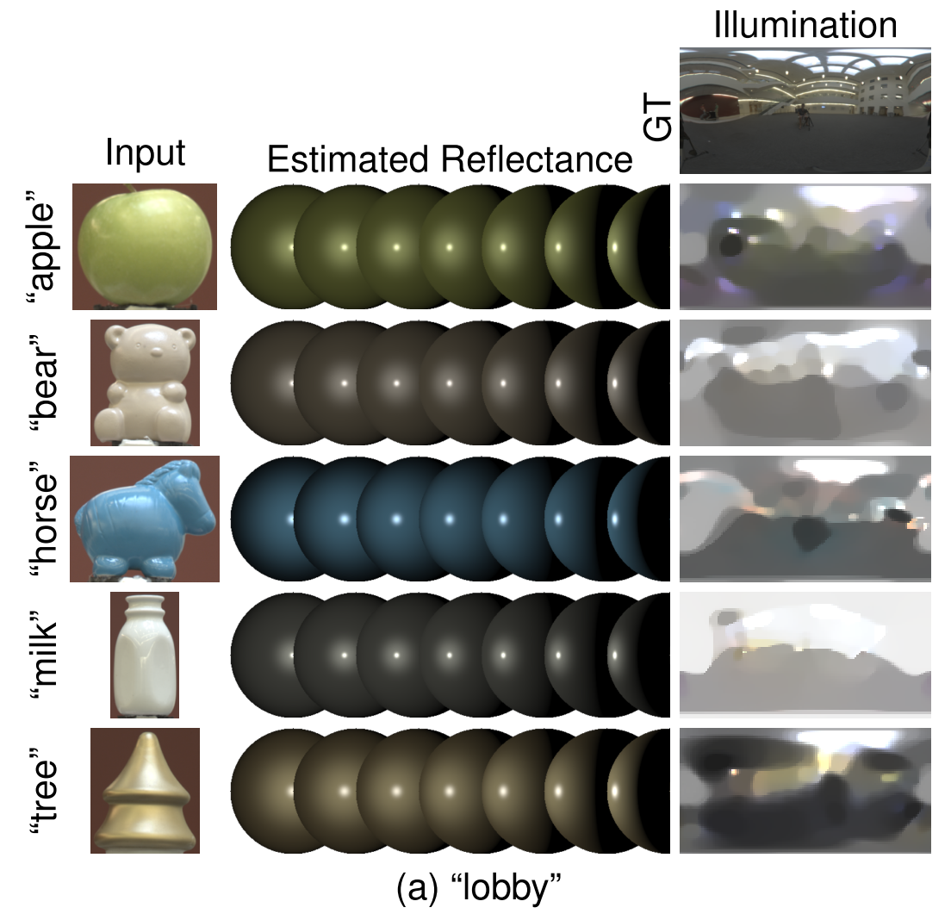
Illumination capture and estimation
2. Handcrafted features
[Lalonde et al ‘12]
3. Parametric sky model
[Hold-Geoffroy et al ’17]
1. Known object in scene [Lombardi et al. ’15]
Notes:
For outdoor lighting, an alternative is to point a fisheye camera at the sky, but you still need multiple exposures and specialized equipment. Researchers also proposed inverse rendering approaches based on known objects in the scene to recover illumination.
For generic outdoor scenes, hand designed features looking at specific cues in the image are typically used, for example pedestrian shadows and shading on building walls.

Slide 13
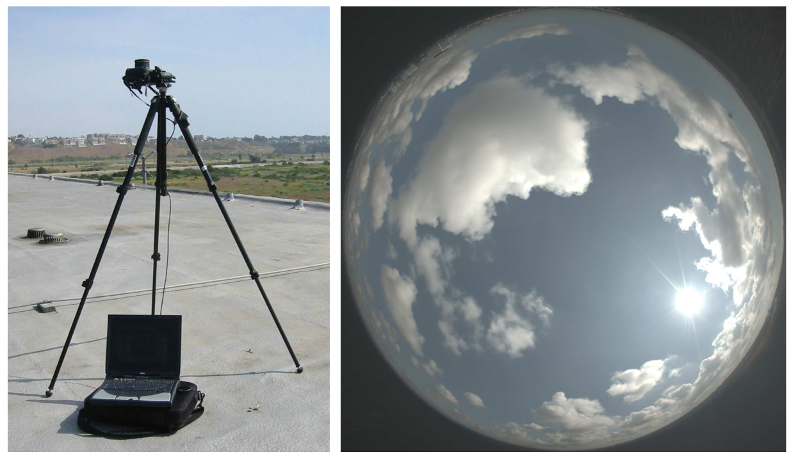
Our work
1. Specialized equipment
[Stumpfel et al. ’04]
3. Handcrafted features
[Lalonde et al ‘12]
Conventional camera
2. Known object in scene [Lombardi et al. ’15]
Learned features
Generic scene
Notes:
In contrast, we have found a method that estimates outdoor lighting using a single photo taken by an conventional off-the-shelf camera, of a generic scene without explicit known object, and relies on features that are automatically learned.

Slide 14
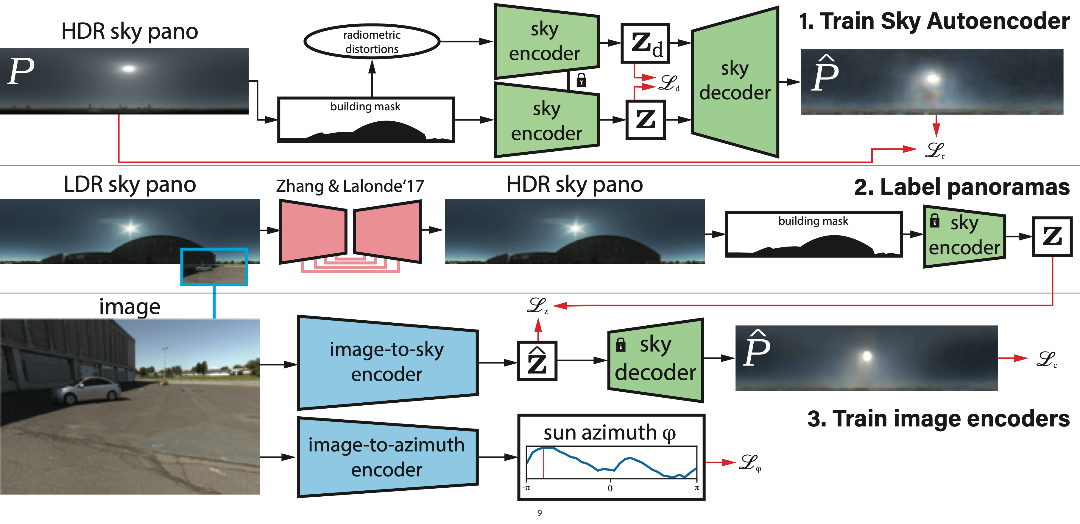
Steps to produce a learned sky model
Notes:
3 steps. First, we train an autoencoder to compress the sky into a Z vector, and to reconstruct the full HDR sky hemisphere from this Z vector. We do two special things during its training: 1) we add random building masks to the model and ask the model to recover the sky under the mask. 2) we add radiometric distortions to the sky (change white balance, exposure, camera response function) and enforce that both distorted and non-distorted Z vectors are the same and we force the reconstruction to be the non-distorted input. This enforces the sky encoder to remove distortions, so Z and the sky decoder does not contain distortions due to capture noise.
Now, we trained the sky autoencoder only on the sky hemisphere. What we want to do is to find a way to encode regular images to this Z vector, in order to get the sky back.
Second step: We need a large dataset of full panoramas (not only the sky) with diversity. We use SUN360, which we augment to HDR using Jinsong’s method, mask out the building, and forward through the sky encoder to obtain the Z vector. Now, we have pairs of panoramas and their corresponding Z vectors.
Third step, we take crops from the panorama, we simulate a camera from the panorama, and ask a neural network to estimate the Z vector from the image. The sky decoder trained in the first step can then generate the sky that can be used for lighting as an envmap (IBL).
Lastly, we did one thing to simplify the auto encoder’s job: all the suns are aligned to be in the center of the environment map—it still can move up and down, but we removed left-right as it does not have an impact on the lighting. This simplifies the autoencoder training. However, at the end, we must estimate the yaw of the sun. Applying it to the sky is simple, it’s a matter of moving the pixels left or right.

Slide 15
Pipeline
Train SkyNet
Annotate SUN360 with SkyNet
Train an image-to-sky encoder

Slide 16
Step 1: Train SkyNet, a Data-Driven Sky Model
Training data from http://sky.hdrdb.com
SkyNet
(with color distortions)
Notes:
First, we train an autoencoder to compress the sky to a Z vector and decompress it back the sky. To ensure robustness to various camera functions, we add radiometric distortions such as random white balance to the sky. We train this autoencoder by minimizing two losses, first we ensure that the encoder removes the distortions by making the latent vector Z the same regardless of input, and second the reconstruction must always match the non-distorted input.

Slide 17
Sky model expressivity
Sunny
Cloudy
Ground truth
SkyNet (ours)
Hošek-Wilkie
Ground truth
SkyNet (ours)
Hošek-Wilkie
Notes:
The resulting sky model can still express accurately sunny weather like previous methods. Here, on the top, you can see the lighting as an environment map, and a render of a bunny lit by this environment map under it.
However, on partially cloudy or overcast days, we see that our learned model can accurately represent the sky energy and produce very similar renders to the GT, contrary to previous work.

Slide 18
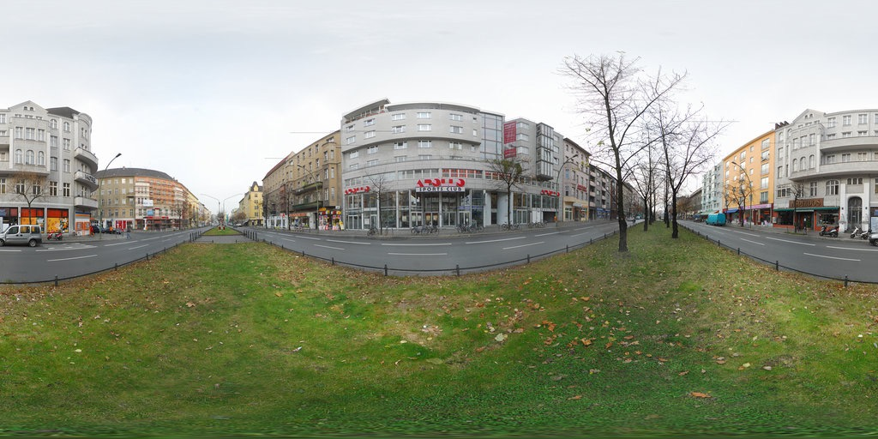
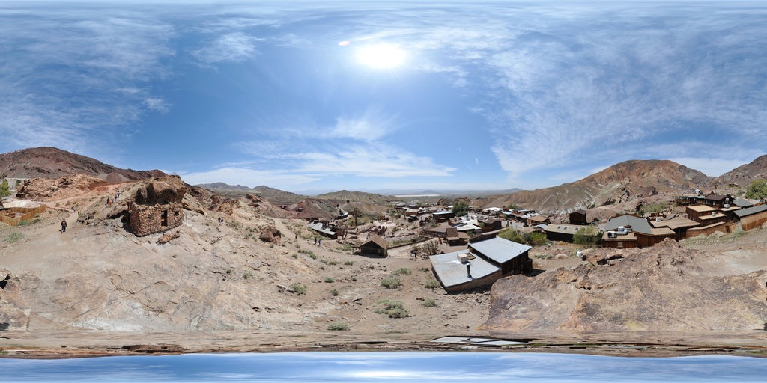
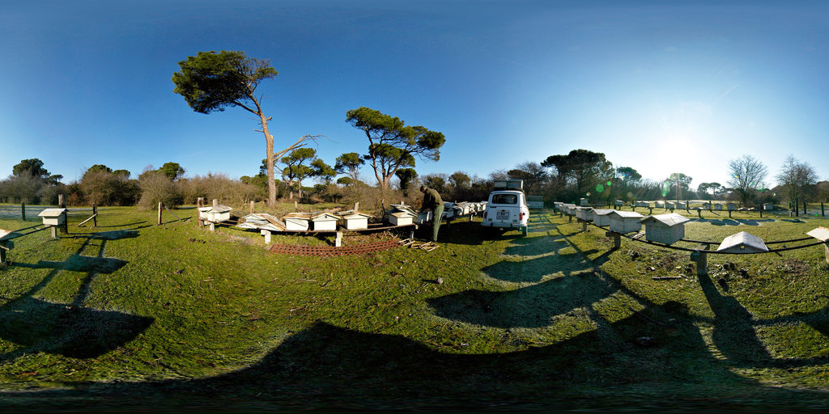
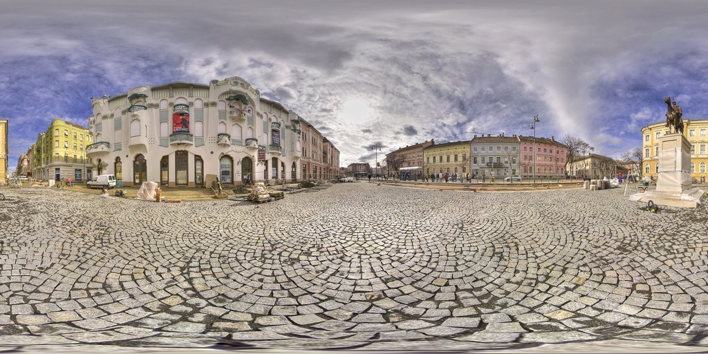
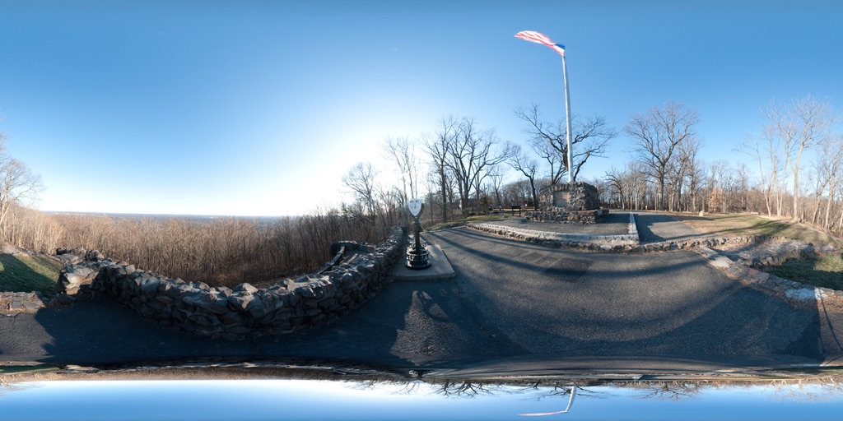
Step 2: Annotate a large panorama dataset with our data-driven sky model
SUN360 (LDR)
SUN360-HDR
SkyNet Encoder
Zhang & Lalonde ’17
LDR HDR
sky only
…
…
Notes:
Now that we have a trained sky model, we will use it to estimate lighting from a single image. To do this, we annotate a large dataset of 360 panoramas by extending SUN360 to HDR using the technique proposed by Zhang & Lalonde. Then, we remove the ground from the panoramas and forward the sky through our SkyNet Encoder, giving a Z vector. We repeat this for every panorama in the dataset, giving pairs of panoramas and its lighting conditions encoded in Z vectors.

Slide 19
Step 3: Learn an image-to-sky encoder
SkyNet
Encoder
(previous step)
Image-to-Sky
Encoder
SkyNet
Decoder
Notes:
Finally, our third step is to crop images from the panoramas, effectively simulating a camera. From those images, we train an image-to-sky encoder to estimate the z of the panorama, obtained in the previous step. At test time, this Z can be decoded to an environment map ready for lighting a virtual scene.

Slide 20
Results on SUN360
Hold-Geoffroy’17
Hold-Geoffroy’17
ground truth
ours
ours
Hold-Geoffroy’17
Hold-Geoffroy’17
ground truth
ours
ours

Slide 21
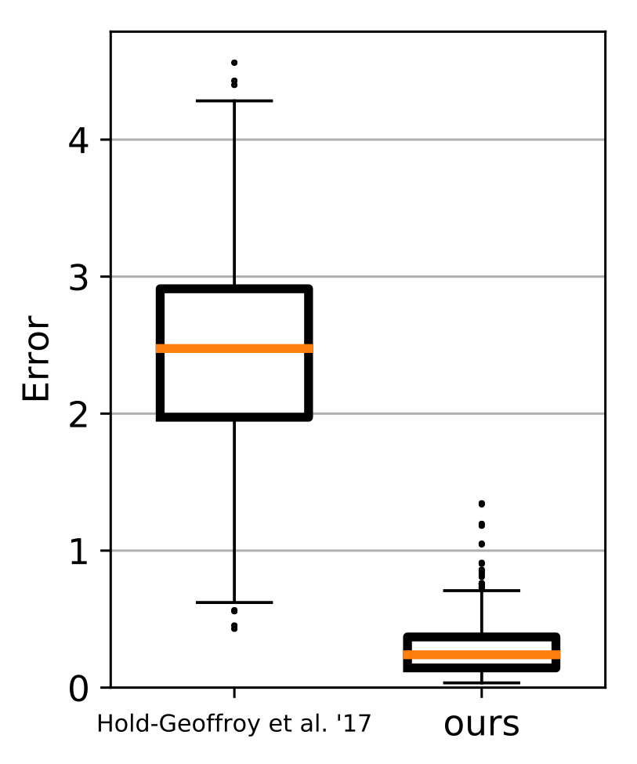
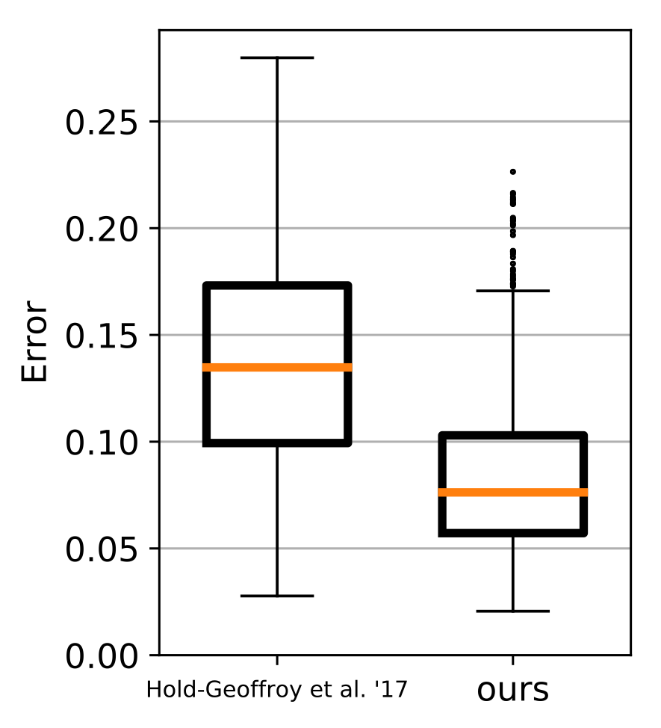
Results on novel HDR dataset
Dataset publicly available: http://outdoor.hdrdb.com
ground truth
ours
Hold-Geoffroy’17
ground truth
ours
Hold-Geoffroy’17
RMSE against ground truth
Scale-Invariant-RMSE against ground truth
Notes:
To validate our method, we capture a novel HDR dataset of outdoor scenes. Here are two results from this dataset. Since we have ground truth, it is possible to compare the difference between ground truth renders and our method. We achieve significantly better than the current state-of-the-art in both RMSE (left) and SI-RMSE (right), due to better exposure estimation and better shadow direction estimation.

Slide 22
New public outdoor HDR dataset captured: http://outdoor.hdrdb.com

Slide 23
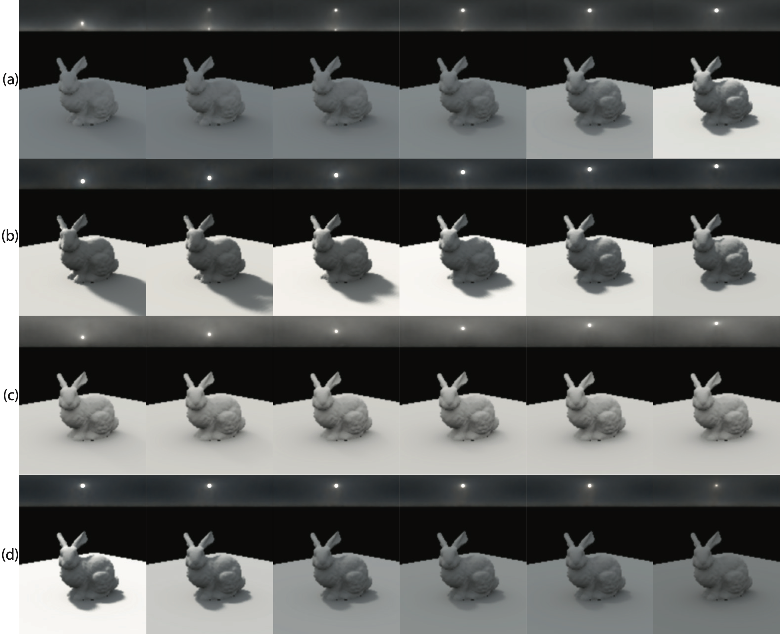
Modifying the sky model properties
Interpolation
(ours) Clear day
(ours) Mostly overcast day
(ours) Changing intensity
Notes:
It is not easy to control our learned sky omdel because it is implicit. Naïvely interpolating between Z vectors generates undesired artifacts like multiple suns.
To circumvent this issue, we develop a method to modify our generated skies. Using this, we can move suns up and down without artifacts in sunny days and in partially cloudy days. We can also control the intensity of the sun.

Slide 24
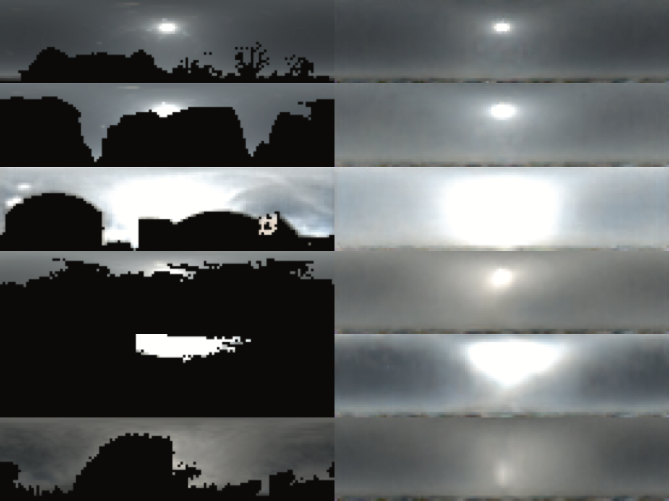
Sky in-filling
input
output
Notes:
Another task that is possible with a sky model is to perform in-filling. Here, we have a sky with regions masked, they could be due to buildings, trees or any occluder. Then we can ask the model to fill in the blank regions with plausible sky energy.

Slide 25
Summary
Notes:
To summarize, we trained an autoencoder to reconstruct skies, then we labeled 360 panoramas using this autoencoder, and used this labeling to learn to produce a sky from a single image. The resulting sky model is data-driven and as expressive as the captures used in training, resulting in accurate lighting estimation in a more variety of weather conditions than previous works.

Slide 26
Deep Sky Modeling for Single Image Outdoor Lighting Estimation
Poster #147
Yannick Hold-Geoffroy, Akshaya Athawale, Jean-François Lalonde
Adobe Research
Indian Institute of Tech. Dhanbad
Université Laval
Notes:
We will be glad to discuss at poster #147 and #154 for both our data-driven and parametric outdoor lighting estimation methods. Thanks for your attention!

Slide 27
Notes:
Thanks! Any questions?

